Slide 1
PROJECT DETAILS
Total Modules – 55 (550 Wp)
Total Wp – 30.25 kWp
Structure Type – Mini Rails

Slide 2
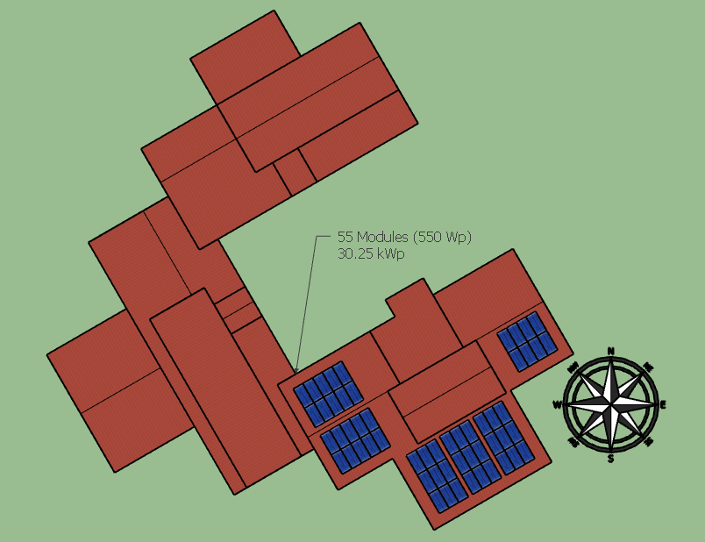
2D VIEW

Slide 3
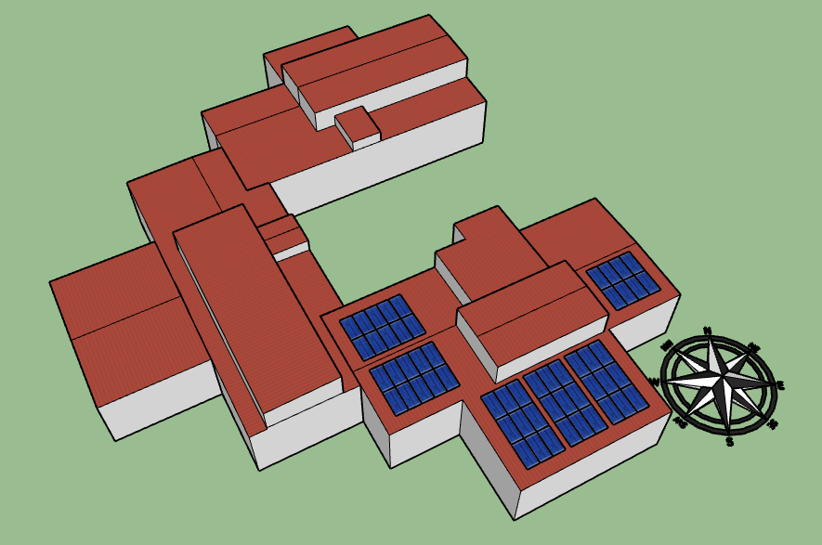
3D VIEW

Slide 4
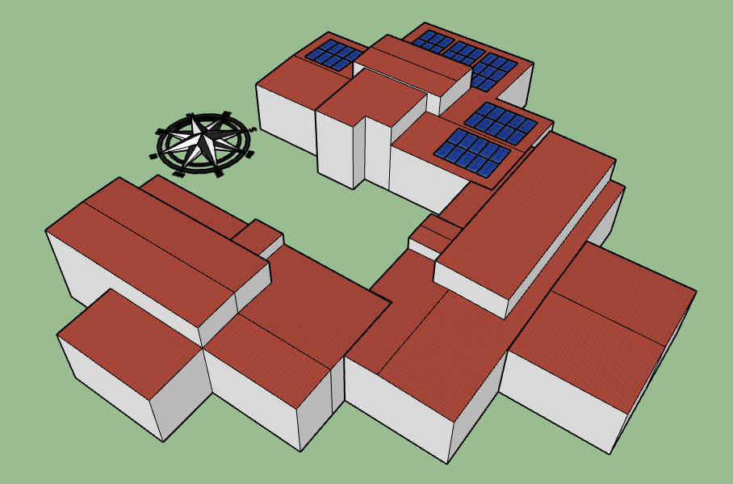
3D VIEW

Slide 5
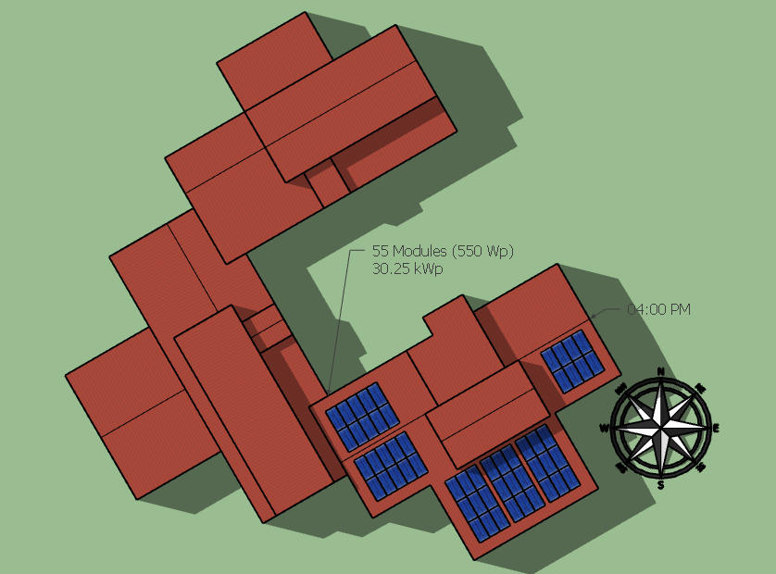
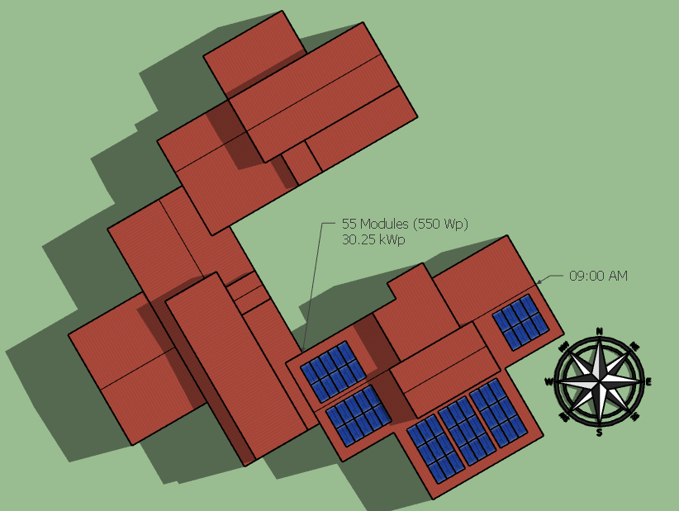
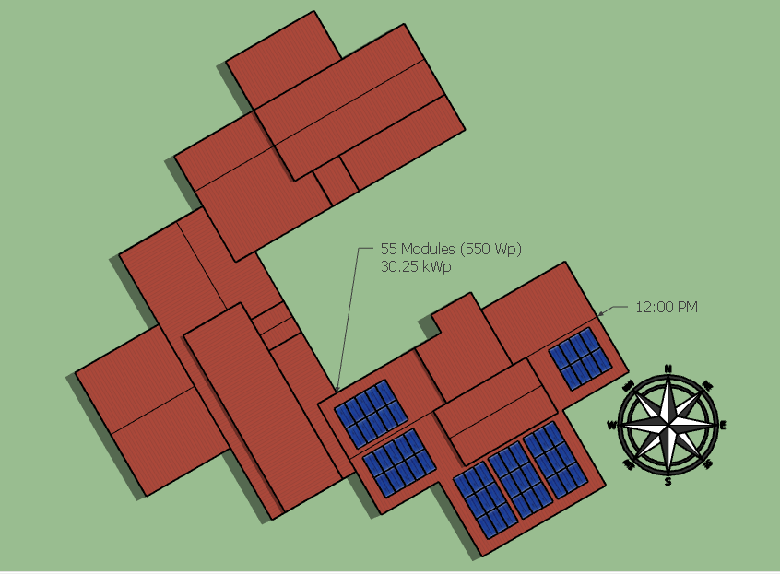
JUNE SHADOWS

Slide 6
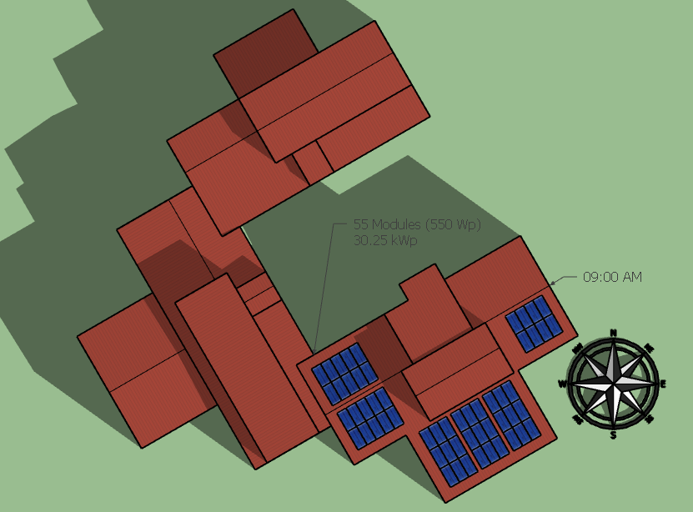
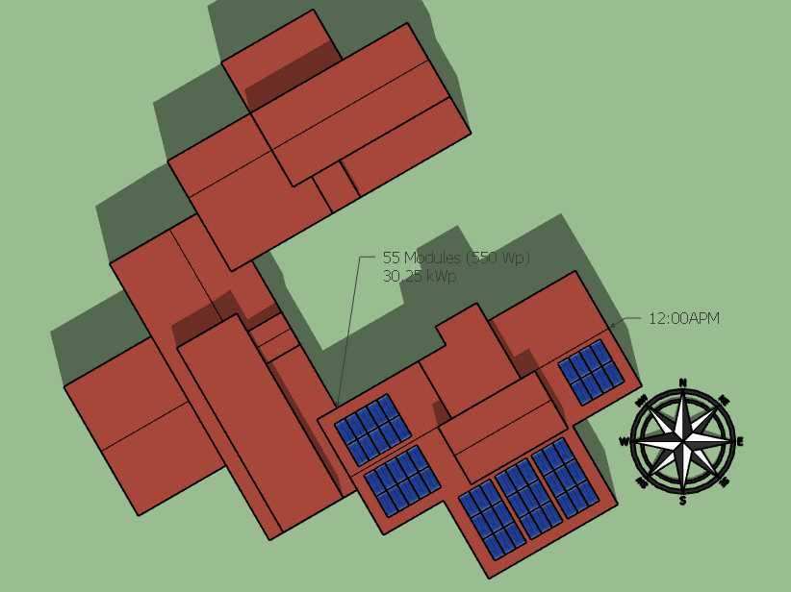
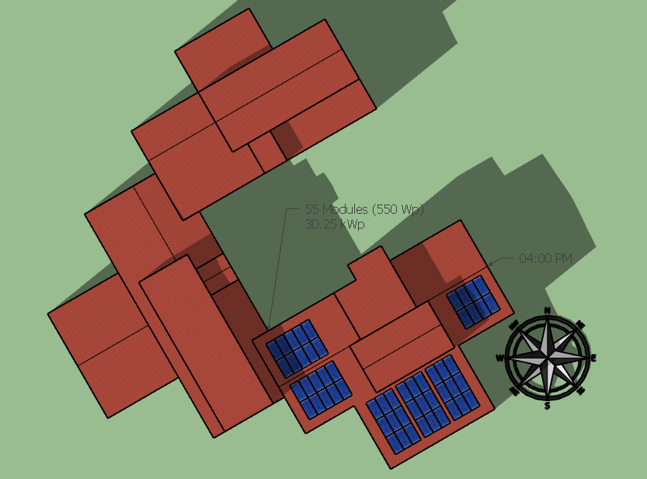
DECEMBER SHADOWS

Slide 7

THANK YOU

